Slide 1



01CE0723 - DATA WAREHOUSING & DATA MINING
Unit - 3
Data Pre-Processing
Prof. Urvi Dhamecha
Assistant Professor
Computer Engineering Department

Slide 2


Outline
Data pre-processing overview
Major tasks in data pre-processing,
Introduction to Data cleaning
Data cleaning process for incomplete and noisy data,
Introduction to Data integration
Correlation Analysis for nominal and numeric data
Covariance analysis for numeric data
Introduction to reduction
Data reduction strategies
Introduction to data transformation
Data normalization techniques
Introduction to data discretization
Data discretization methods
Box and whisker plot using five number summary
Quartile for outlier detection

Slide 3
Overview
Data preprocessing is the process of preparing raw data for analysis by cleaning and transforming it into a usable format. In data mining it refers to preparing raw data for mining by performing tasks like cleaning, transforming, and organizing it into a format suitable for mining algorithms.

Slide 4
Overview
Why to preprocess the data? : Data Quality
Measures for data quality:
Accuracy: correct or wrong, accurate or not
Completeness: not recorded, unavailable, …
Consistency: some modified but some not, dangling, …
Timeliness: timely update?
Believability: how trustable the data are correct?
Interpretability: how easily the data can be understood?

Slide 5
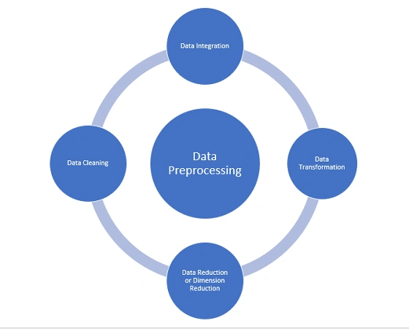
Overview

Slide 6
Overview
Major Task in Data Preprocessing
1. Data cleaning
- Fill in missing values, smooth noisy data, identify or remove outliers, and resolve inconsistencies
2. Data integration
- Integration of multiple databases, data cubes, or files
3. Data reduction
- Dimensionality reduction
- Numerosity reduction
- Data compression
4. Data transformation and data discretization
- Normalization
- Concept hierarchy generation

Slide 7
3.1 Data Cleaning
Data in the Real World Is Dirty: Lots of potentially incorrect data, e.g., instrument faulty, human or computer error, transmission error
incomplete: lacking attribute values, lacking certain attributes of interest, or containing only aggregate data
e.g., Occupation=“ ” (missing data)
noisy: containing noise, errors, or outliers
e.g., Salary=“−10” (an error)
inconsistent: containing discrepancies in codes or names, e.g.,
Age=“42”, Birthday=“03/07/2010”
Was rating “1, 2, 3”, now rating “A, B, C”
discrepancy between duplicate records
Intentional (e.g., disguised missing data)
Jan. 1 as everyone’s birthday?

Slide 8
3.1 Data Cleaning (cont.) : Incomplete (Missing Data)
Data is not always available
E.g., many tuples have no recorded value for several attributes, such as customer income in sales data
Missing data may be due to
equipment malfunction
inconsistent with other recorded data and thus deleted
data not entered due to misunderstanding
certain data may not be considered important at the time of entry
not register history or changes of the data
Missing data may need to be inferred

Slide 9
3.1 Data Cleaning (cont.) : How to handle missing data?
Ignore the tuple: usually done when class label is missing (when doing classification)—not effective when the % of missing values per attribute varies considerably
Fill in the missing value manually: tedious + infeasible?
Fill in it automatically with
a global constant : e.g., “unknown”, a new class?!
the attribute mean
the attribute mean for all samples belonging to the same class: smarter
the most probable value: inference-based such as Bayesian formula or decision tree

Slide 10
3.1 Data Cleaning (cont.) : How to handle noisy data?
Binning
first sort data and partition into (equal-frequency) bins
then one can smooth by bin means, smooth by bin median, smooth by bin boundaries, etc.
Regression
smooth by fitting the data into regression functions
Clustering
detect and remove outliers
Combined computer and human inspection
detect suspicious values and check by human (e.g., deal with possible outliers)

Slide 11
Binning Methods
Equal-width (distance) partitioning:
It divides the range into N intervals of equal size: uniform grid
if A and B are the lowest and highest values of the attribute, the width of intervals will be: W = (B-A)/N.
The most straightforward
But outliers may dominate presentation
Skewed data is not handled well.
The algorithm divides the data into k intervals of equal size. The width of intervals is: w = (max-min)/k And the interval boundaries are: min+w, min+2w, ... , min+(k-1)w
Equal-depth (frequency) partitioning:
It divides the range into N intervals, each containing approximately same number of samples
Good data scaling – good handing of skewed data

Slide 12
Binning Methods for Data Smoothing
* Sorted data for price (in dollars): 4, 8, 9, 15, 21, 21, 24, 25, 26, 28, 29, 34
* Partition into (equi-width) bins:
- Bin 1 (4-14): 4, 8, 9
- Bin 2(15-24): 15, 21, 21, 24
- Bin 3(25-34): 25, 26, 28, 29, 34
* Smoothing by bin means:
- Bin 1: 7, 7, 7
- Bin 2: 20, 20, 20, 20
- Bin 3: 28, 28, 28, 28, 28
* Smoothing by bin boundaries:
- Bin 1: 4, 4, 4
- Bin 2: 15, 24, 24, 24
- Bin 3: 25, 25, 25, 25, 34

Slide 13
(continued)
* Sorted data for price (in dollars): 4, 8, 9, 15, 21, 21, 24, 25, 26, 28, 29, 34
* Partition into (equi-depth) bins:
- Bin 1: 4, 8, 9, 15
- Bin 2: 21, 21, 24, 25
- Bin 3: 26, 28, 29, 34
* Smoothing by bin means:
- Bin 1: 9, 9, 9, 9
- Bin 2: 23, 23, 23, 23
- Bin 3: 29, 29, 29, 29
* Smoothing by bin boundaries:
- Bin 1: 4, 4, 4, 15
- Bin 2: 21, 21, 25, 25
- Bin 3: 26, 26, 26, 34

Slide 14
Cluster Analysis
Allows detection and removal of outliers

Slide 15
Regression
y
Y1
Y1’
y = x + 1
X1
x
Linear regression – find the best line to fit two variables and
use regression function to smooth data

Slide 16

Thank You

